Slide 1
SYNCHRONOUS COUNTER 4-BINARY COUNTER
Lecture 11
Part 1

Slide 2
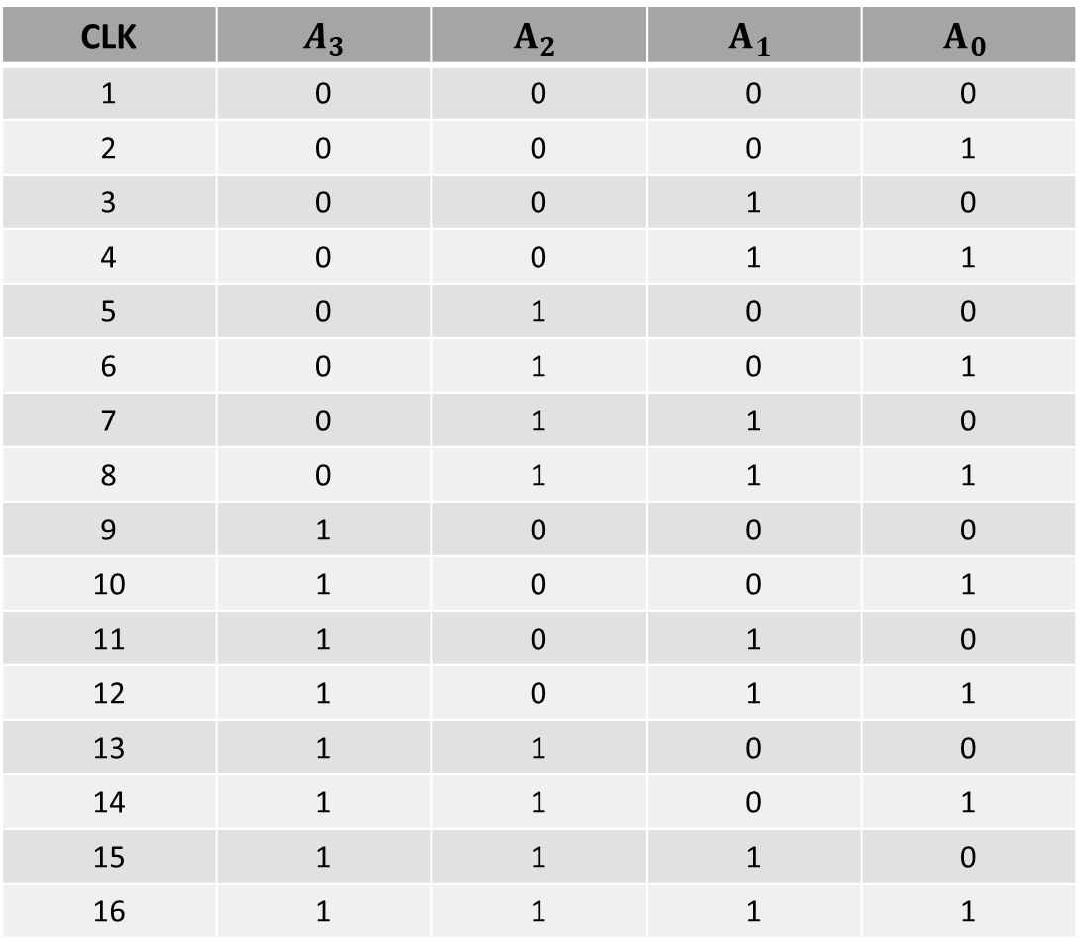
4-BIT UP BINARY COUNTER
CLK | $$A_{3}$$ | $$A_{2}$$ | $$A_{1}$$ | $$A_{0}$$
1 | 0 | 0 | 0 | 0
2 | 0 | 0 | 0 | 1
3 | 0 | 0 | 1 | 0
4 | 0 | 0 | 1 | 1
5 | 0 | 1 | 0 | 0
6 | 0 | 1 | 0 | 1
7 | 0 | 1 | 1 | 0
8 | 0 | 1 | 1 | 1
9 | 1 | 0 | 0 | 0
10 | 1 | 0 | 0 | 1
11 | 1 | 0 | 1 | 0
12 | 1 | 0 | 1 | 1
13 | 1 | 1 | 0 | 0
14 | 1 | 1 | 0 | 1
15 | 1 | 1 | 1 | 0
16 | 1 | 1 | 1 | 1

Slide 3
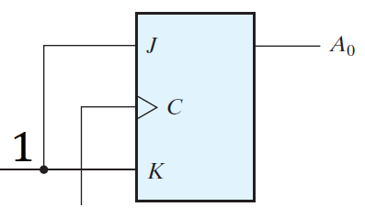
4-BIT UP BINARY COUNTER

Slide 4
4-BIT UP BINARY COUNTER
CLK | $$A_{3}$$ | $$A_{2}$$ | $$A_{1}$$ | $$A_{0}$$
1 | 0 | 0 | 0 | 0
2 | 0 | 0 | 0 | 1
3 | 0 | 0 | 1 | 0
4 | 0 | 0 | 1 | 1
5 | 0 | 1 | 0 | 0
6 | 0 | 1 | 0 | 1
7 | 0 | 1 | 1 | 0
8 | 0 | 1 | 1 | 1
9 | 1 | 0 | 0 | 0
10 | 1 | 0 | 0 | 1
11 | 1 | 0 | 1 | 0
12 | 1 | 0 | 1 | 1
13 | 1 | 1 | 0 | 0
14 | 1 | 1 | 0 | 1
15 | 1 | 1 | 1 | 0
16 | 1 | 1 | 1 | 1

Slide 5
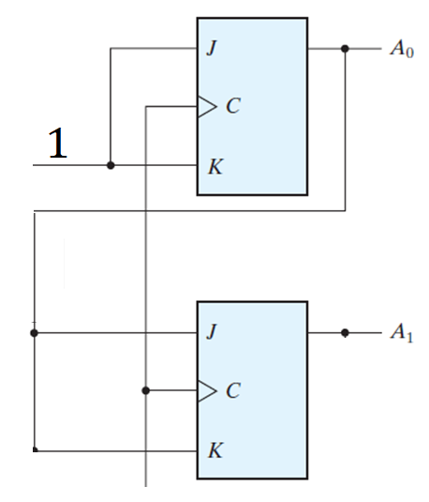
4-BIT UP BINARY COUNTER

Slide 6
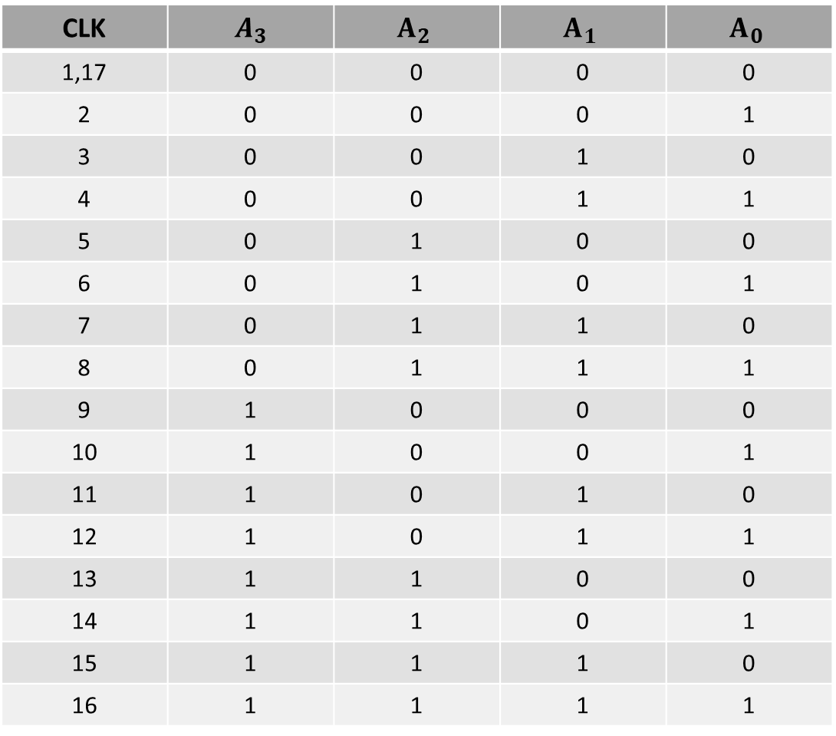
4-BIT UP BINARY COUNTER
CLK | $$A_{3}$$ | $$A_{2}$$ | $$A_{1}$$ | $$A_{0}$$
1,17 | 0 | 0 | 0 | 0
2 | 0 | 0 | 0 | 1
3 | 0 | 0 | 1 | 0
4 | 0 | 0 | 1 | 1
5 | 0 | 1 | 0 | 0
6 | 0 | 1 | 0 | 1
7 | 0 | 1 | 1 | 0
8 | 0 | 1 | 1 | 1
9 | 1 | 0 | 0 | 0
10 | 1 | 0 | 0 | 1
11 | 1 | 0 | 1 | 0
12 | 1 | 0 | 1 | 1
13 | 1 | 1 | 0 | 0
14 | 1 | 1 | 0 | 1
15 | 1 | 1 | 1 | 0
16 | 1 | 1 | 1 | 1

Slide 7
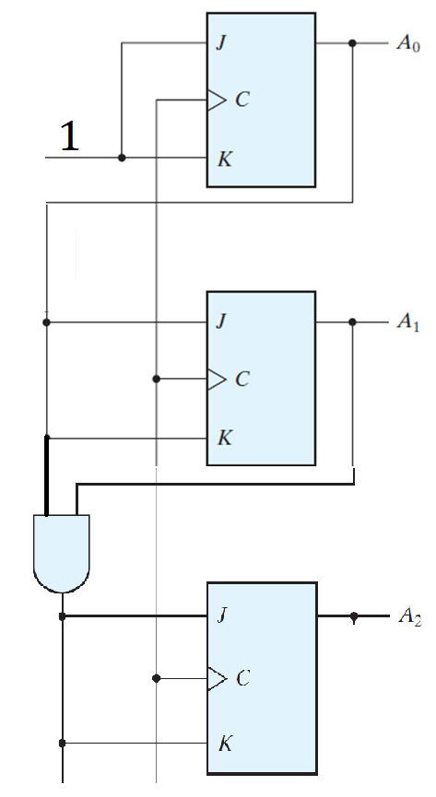
4-BIT UP BINARY COUNTER

Slide 8
4-BIT UP BINARY COUNTER
CLK | $$A_{3}$$ | $$A_{2}$$ | $$A_{1}$$ | $$A_{0}$$
1,17 | 0 | 0 | 0 | 0
2 | 0 | 0 | 0 | 1
3 | 0 | 0 | 1 | 0
4 | 0 | 0 | 1 | 1
5 | 0 | 1 | 0 | 0
6 | 0 | 1 | 0 | 1
7 | 0 | 1 | 1 | 0
8 | 0 | 1 | 1 | 1
9 | 1 | 0 | 0 | 0
10 | 1 | 0 | 0 | 1
11 | 1 | 0 | 1 | 0
12 | 1 | 0 | 1 | 1
13 | 1 | 1 | 0 | 0
14 | 1 | 1 | 0 | 1
15 | 1 | 1 | 1 | 0
16 | 1 | 1 | 1 | 1

Slide 9
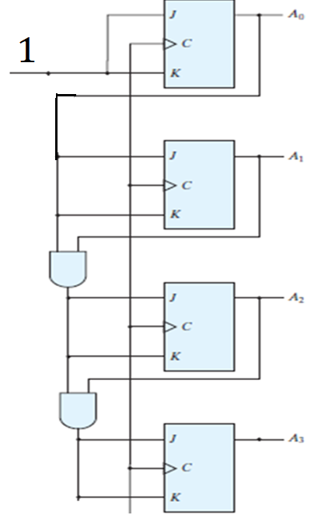
4-BIT UP BINARY COUNTER

Slide 10
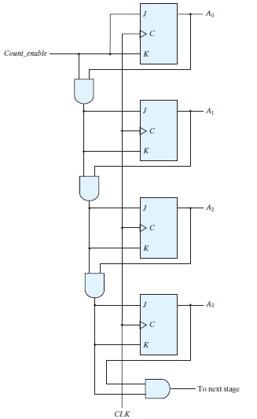
4-BIT UP BINARY COUNTER WITH ENABLE

Slide 11
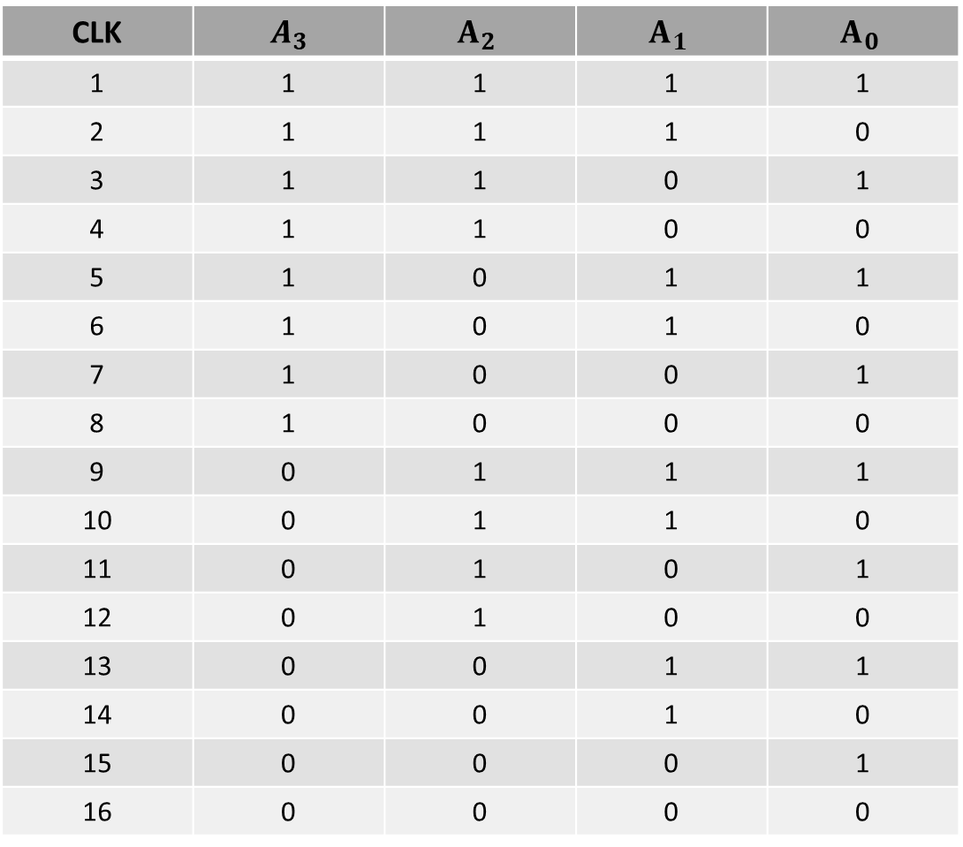
4-BIT DOWN BINARY COUNTER
CLK | $$A_{3}$$ | $$A_{2}$$ | $$A_{1}$$ | $$A_{0}$$
1 | 1 | 1 | 1 | 1
2 | 1 | 1 | 1 | 0
3 | 1 | 1 | 0 | 1
4 | 1 | 1 | 0 | 0
5 | 1 | 0 | 1 | 1
6 | 1 | 0 | 1 | 0
7 | 1 | 0 | 0 | 1
8 | 1 | 0 | 0 | 0
9 | 0 | 1 | 1 | 1
10 | 0 | 1 | 1 | 0
11 | 0 | 1 | 0 | 1
12 | 0 | 1 | 0 | 0
13 | 0 | 0 | 1 | 1
14 | 0 | 0 | 1 | 0
15 | 0 | 0 | 0 | 1
16 | 0 | 0 | 0 | 0

Slide 12
4-BIT DOWN BINARY COUNTER

Slide 13
4-BIT UP BINARY COUNTER
CLK | $$A_{3}$$ | $$A_{2}$$ | $$A_{1}$$ | $$A_{0}$$
1 | 1 | 1 | 1 | 1
2 | 1 | 1 | 1 | 0
3 | 1 | 1 | 0 | 1
4 | 1 | 1 | 0 | 0
5 | 1 | 0 | 1 | 1
6 | 1 | 0 | 1 | 0
7 | 1 | 0 | 0 | 1
8 | 1 | 0 | 0 | 0
9 | 0 | 1 | 1 | 1
10 | 0 | 1 | 1 | 0
11 | 0 | 1 | 0 | 1
12 | 0 | 1 | 0 | 0
13 | 0 | 0 | 1 | 1
14 | 0 | 0 | 1 | 0
15 | 0 | 0 | 0 | 1
16 | 0 | 0 | 0 | 0

Slide 14
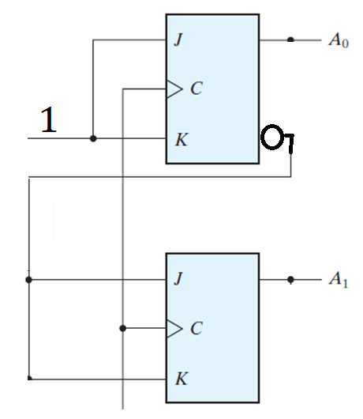
4-BIT BINARY COUNTER

Slide 15
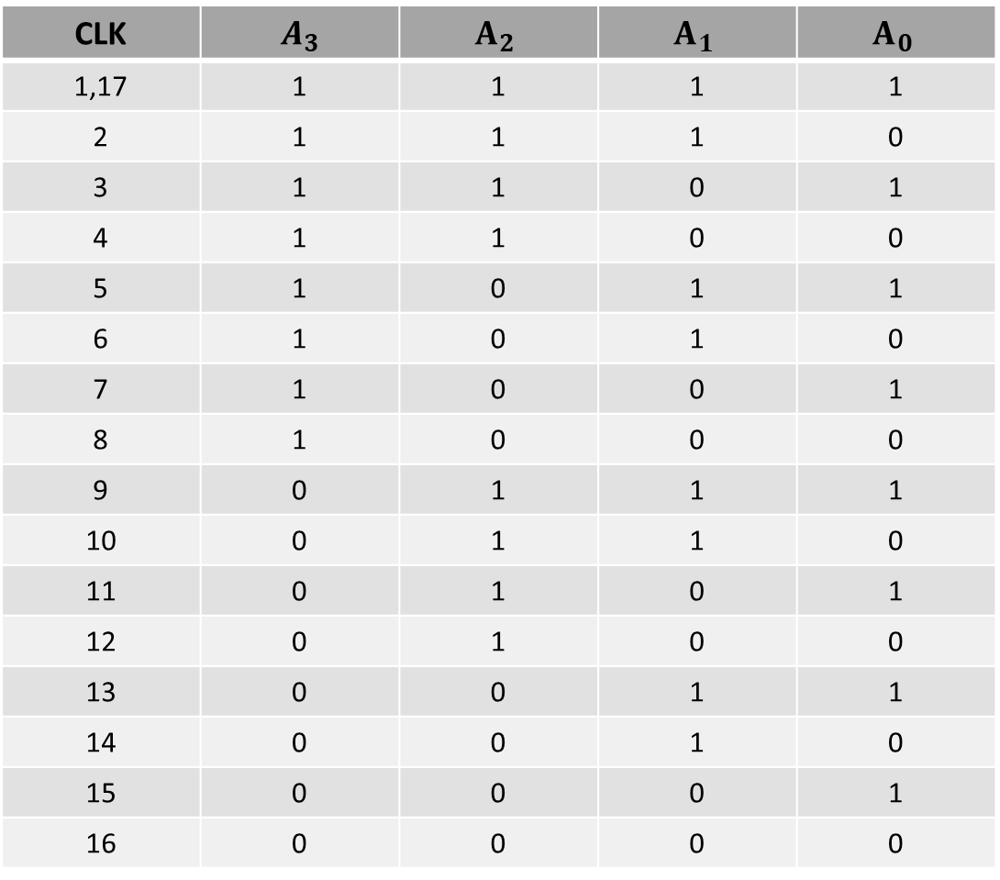
4-BIT UP BINARY COUNTER
CLK | $$A_{3}$$ | $$A_{2}$$ | $$A_{1}$$ | $$A_{0}$$
1,17 | 1 | 1 | 1 | 1
2 | 1 | 1 | 1 | 0
3 | 1 | 1 | 0 | 1
4 | 1 | 1 | 0 | 0
5 | 1 | 0 | 1 | 1
6 | 1 | 0 | 1 | 0
7 | 1 | 0 | 0 | 1
8 | 1 | 0 | 0 | 0
9 | 0 | 1 | 1 | 1
10 | 0 | 1 | 1 | 0
11 | 0 | 1 | 0 | 1
12 | 0 | 1 | 0 | 0
13 | 0 | 0 | 1 | 1
14 | 0 | 0 | 1 | 0
15 | 0 | 0 | 0 | 1
16 | 0 | 0 | 0 | 0

Slide 16
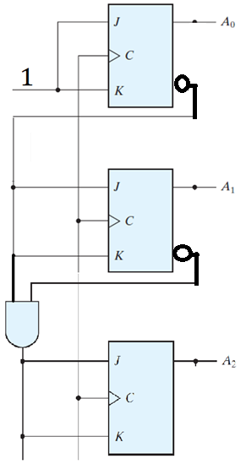
4-BIT BINARY COUNTER

Slide 17
4-BIT UP BINARY COUNTER
CLK | $$A_{3}$$ | $$A_{2}$$ | $$A_{1}$$ | $$A_{0}$$
1,17 | 1 | 1 | 1 | 1
2 | 1 | 1 | 1 | 0
3 | 1 | 1 | 0 | 1
4 | 1 | 1 | 0 | 0
5 | 1 | 0 | 1 | 1
6 | 1 | 0 | 1 | 0
7 | 1 | 0 | 0 | 1
8 | 1 | 0 | 0 | 0
9 | 0 | 1 | 1 | 1
10 | 0 | 1 | 1 | 0
11 | 0 | 1 | 0 | 1
12 | 0 | 1 | 0 | 0
13 | 0 | 0 | 1 | 1
14 | 0 | 0 | 1 | 0
15 | 0 | 0 | 0 | 1
16 | 0 | 0 | 0 | 0

Slide 18
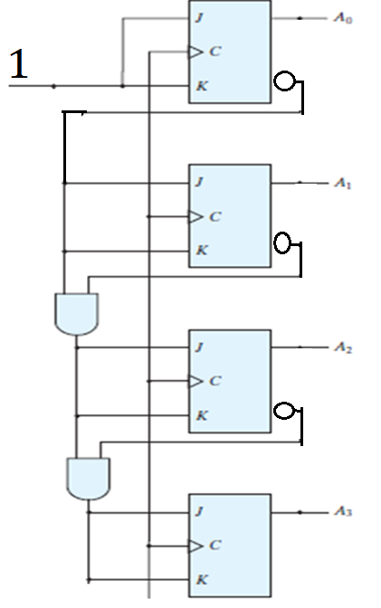
4-BIT BINARY COUNTER

Slide 19
BCD SYNCHRONOUS COUNTER
LECTURE 10
Part 2

Slide 20
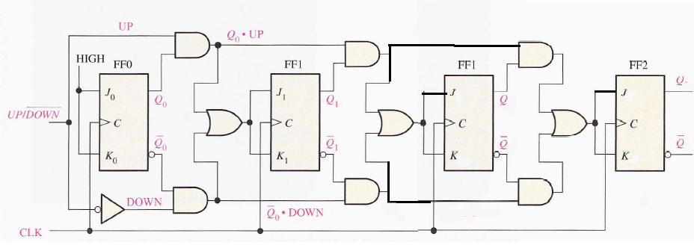
4-BIT UP/DOWN COUNTER

Slide 21
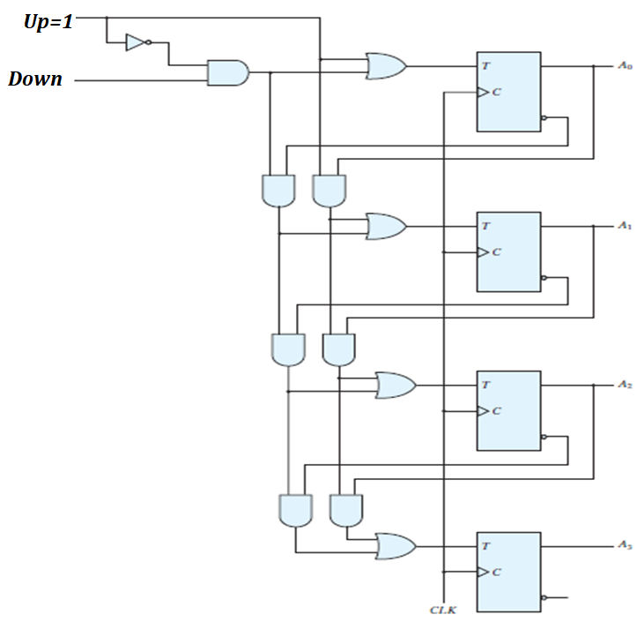
4-BIT UP/DOWN COUNTER

Slide 22
4-BIT UP/DOWN COUNTER
UP | DOWN | COMMENT
0 | 0
0 | 1
1 | 0
1 | 1

Slide 23
4-BIT UP/DOWN COUNTER

Slide 24
4-BIT UP/DOWN COUNTER
UP | DOWN | COMMENT
0 | 0
0 | 1
1 | X | UP

Slide 25
4-BIT UP/DOWN COUNTER
UP | DOWN | COMMENT
0 | 0
0 | 1
1 | X | UP

Slide 26
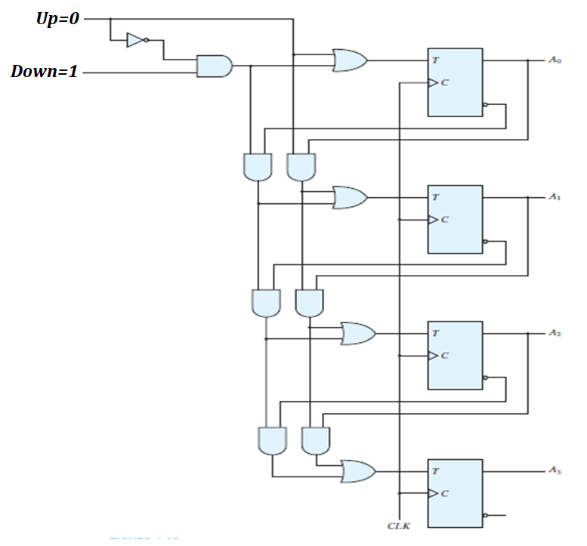
4-BIT UP/DOWN COUNTER

Slide 27
4-BIT UP/DOWN COUNTER
UP | DOWN | COMMENT
0 | 0
0 | 1 | DOWN
1 | X | UP

Slide 28
4-BIT UP/DOWN COUNTER
UP | DOWN | COMMENT
0 | 0
0 | 1 | DOWN
1 | X | UP

Slide 29
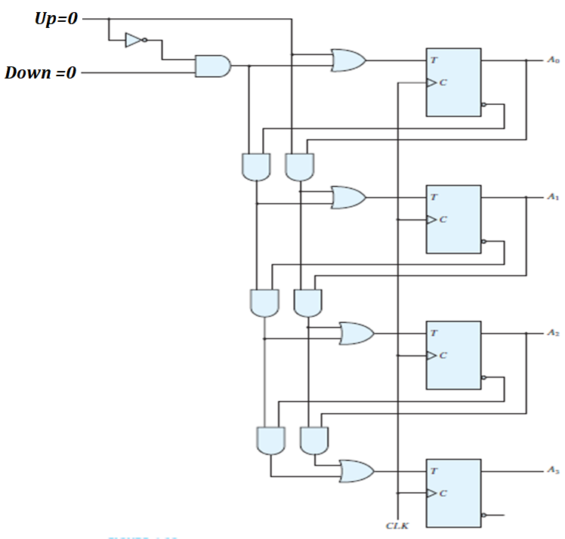
4-BIT UP/DOWN COUNTER

Slide 30
4-BIT UP/DOWN COUNTER
UP | DOWN | COMMENT
0 | 0 | NO CHANGE
0 | 1 | DOWN
1 | X | UP

Slide 31
THANKS

Slide 32
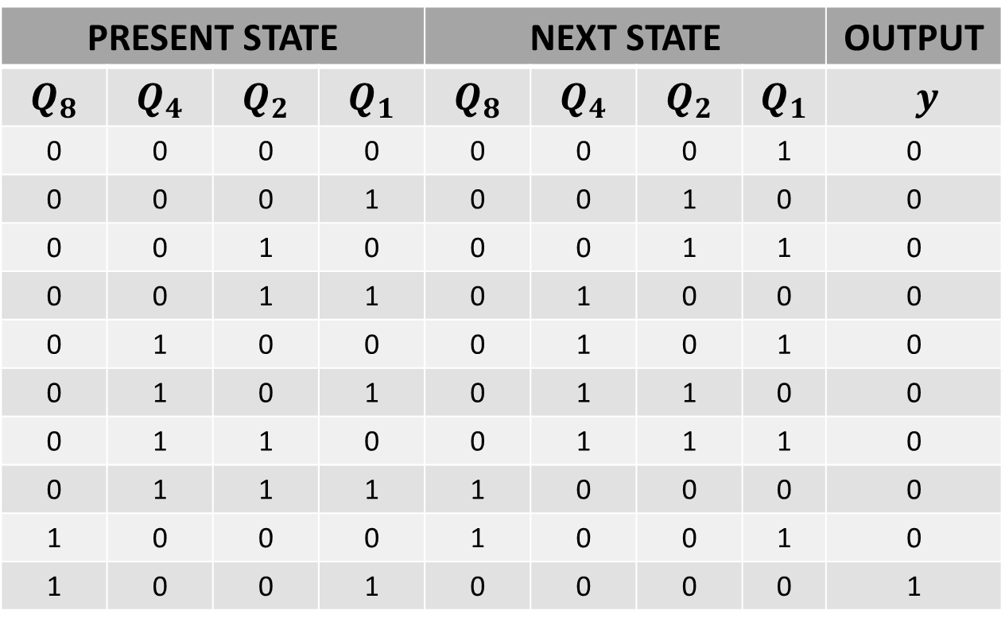
BCD COUNTER
PRESENT STATE |  |  |  | NEXT STATE |  |  |  | OUTPUT
$$Q_{8}$$ | $$Q_{4}$$ | $$Q_{2}$$ | $$Q_{1}$$ | $$Q_{8}$$ | $$Q_{4}$$ | $$Q_{2}$$ | $$Q_{1}$$ | $y$
0 | 0 | 0 | 0 | 0 | 0 | 0 | 1 | 0
0 | 0 | 0 | 1 | 0 | 0 | 1 | 0 | 0
0 | 0 | 1 | 0 | 0 | 0 | 1 | 1 | 0
0 | 0 | 1 | 1 | 0 | 1 | 0 | 0 | 0
0 | 1 | 0 | 0 | 0 | 1 | 0 | 1 | 0
0 | 1 | 0 | 1 | 0 | 1 | 1 | 0 | 0
0 | 1 | 1 | 0 | 0 | 1 | 1 | 1 | 0
0 | 1 | 1 | 1 | 1 | 0 | 0 | 0 | 0
1 | 0 | 0 | 0 | 1 | 0 | 0 | 1 | 0
1 | 0 | 0 | 1 | 0 | 0 | 0 | 0 | 1

Slide 33
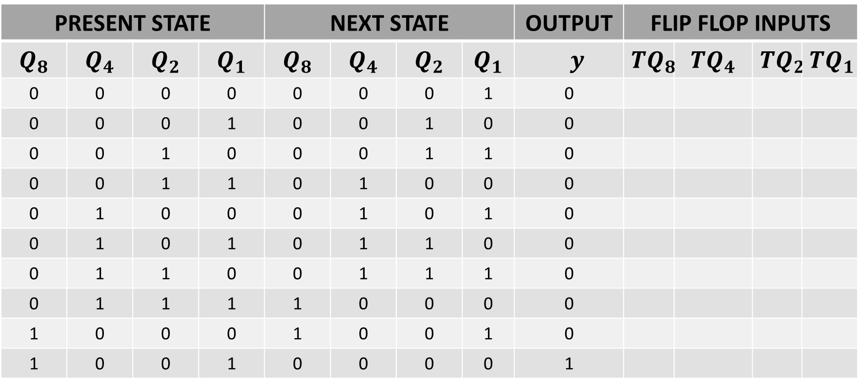
BCD COUNTER
PRESENT STATE |  |  |  | NEXT STATE |  |  |  | OUTPUT | FLIP FLOP INPUTS
$$Q_{8}$$ | $$Q_{4}$$ | $$Q_{2}$$ | $$Q_{1}$$ | $$Q_{8}$$ | $$Q_{4}$$ | $$Q_{2}$$ | $$Q_{1}$$ | $y$ | $${TQ}_{8}$$ | $${TQ}_{4}$$ | $${TQ}_{2}$$ | $${TQ}_{1}$$
0 | 0 | 0 | 0 | 0 | 0 | 0 | 1 | 0
0 | 0 | 0 | 1 | 0 | 0 | 1 | 0 | 0
0 | 0 | 1 | 0 | 0 | 0 | 1 | 1 | 0
0 | 0 | 1 | 1 | 0 | 1 | 0 | 0 | 0
0 | 1 | 0 | 0 | 0 | 1 | 0 | 1 | 0
0 | 1 | 0 | 1 | 0 | 1 | 1 | 0 | 0
0 | 1 | 1 | 0 | 0 | 1 | 1 | 1 | 0
0 | 1 | 1 | 1 | 1 | 0 | 0 | 0 | 0
1 | 0 | 0 | 0 | 1 | 0 | 0 | 1 | 0
1 | 0 | 0 | 1 | 0 | 0 | 0 | 0 | 1

Slide 34
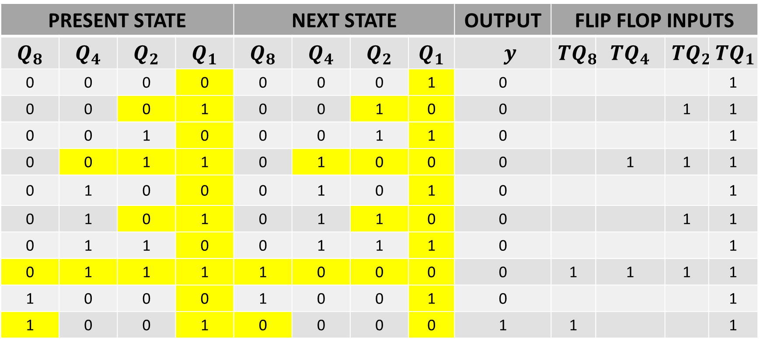
BCD COUNTER
PRESENT STATE |  |  |  | NEXT STATE |  |  |  | OUTPUT | FLIP FLOP INPUTS
$$Q_{8}$$ | $$Q_{4}$$ | $$Q_{2}$$ | $$Q_{1}$$ | $$Q_{8}$$ | $$Q_{4}$$ | $$Q_{2}$$ | $$Q_{1}$$ | $y$ | $${TQ}_{8}$$ | $${TQ}_{4}$$ | $${TQ}_{2}$$ | $${TQ}_{1}$$
0 | 0 | 0 | 0 | 0 | 0 | 0 | 1 | 0 |  |  |  | 1
0 | 0 | 0 | 1 | 0 | 0 | 1 | 0 | 0 |  |  | 1 | 1
0 | 0 | 1 | 0 | 0 | 0 | 1 | 1 | 0 |  |  |  | 1
0 | 0 | 1 | 1 | 0 | 1 | 0 | 0 | 0 |  | 1 | 1 | 1
0 | 1 | 0 | 0 | 0 | 1 | 0 | 1 | 0 |  |  |  | 1
0 | 1 | 0 | 1 | 0 | 1 | 1 | 0 | 0 |  |  | 1 | 1
0 | 1 | 1 | 0 | 0 | 1 | 1 | 1 | 0 |  |  |  | 1
0 | 1 | 1 | 1 | 1 | 0 | 0 | 0 | 0 | 1 | 1 | 1 | 1
1 | 0 | 0 | 0 | 1 | 0 | 0 | 1 | 0 |  |  |  | 1
1 | 0 | 0 | 1 | 0 | 0 | 0 | 0 | 1 | 1 |  |  | 1

Slide 35
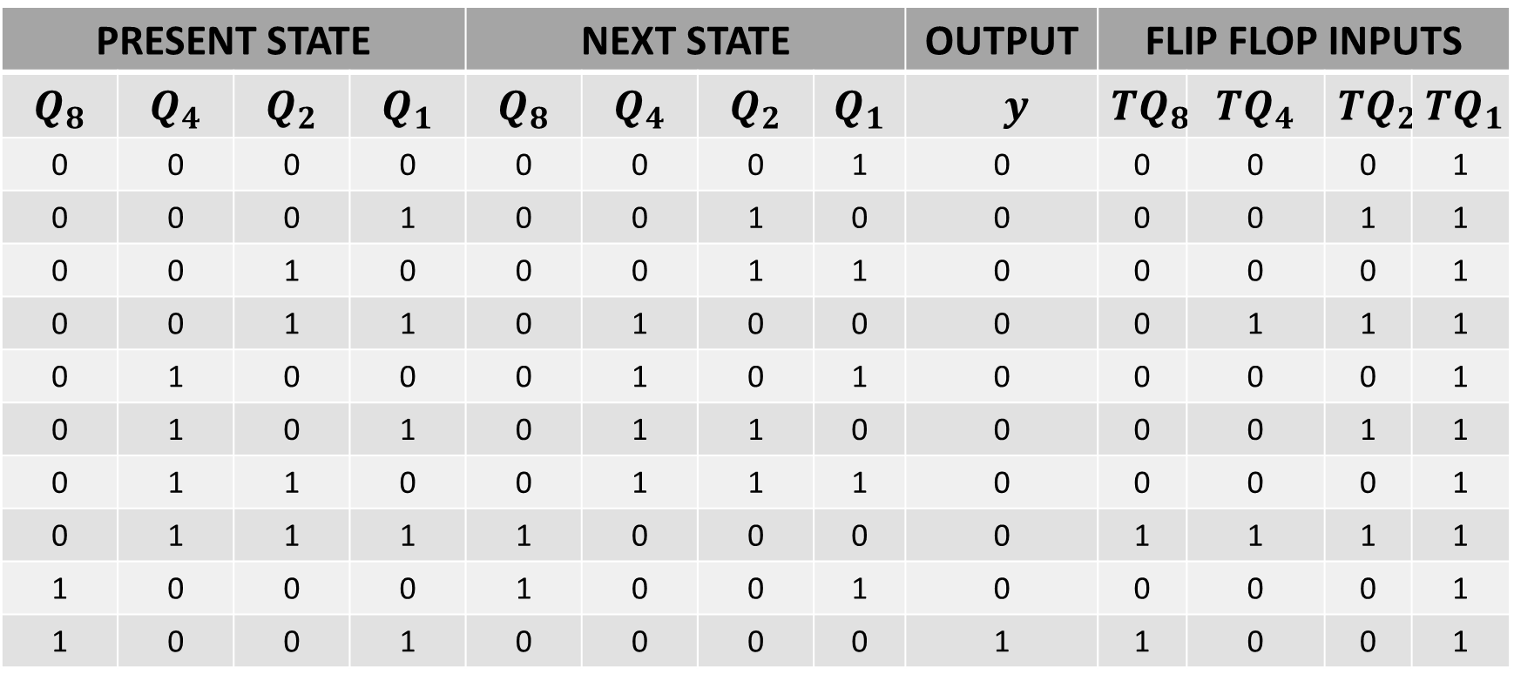
BCD COUNTER
PRESENT STATE |  |  |  | NEXT STATE |  |  |  | OUTPUT | FLIP FLOP INPUTS
$$Q_{8}$$ | $$Q_{4}$$ | $$Q_{2}$$ | $$Q_{1}$$ | $$Q_{8}$$ | $$Q_{4}$$ | $$Q_{2}$$ | $$Q_{1}$$ | $y$ | $${TQ}_{8}$$ | $${TQ}_{4}$$ | $${TQ}_{2}$$ | $${TQ}_{1}$$
0 | 0 | 0 | 0 | 0 | 0 | 0 | 1 | 0 | 0 | 0 | 0 | 1
0 | 0 | 0 | 1 | 0 | 0 | 1 | 0 | 0 | 0 | 0 | 1 | 1
0 | 0 | 1 | 0 | 0 | 0 | 1 | 1 | 0 | 0 | 0 | 0 | 1
0 | 0 | 1 | 1 | 0 | 1 | 0 | 0 | 0 | 0 | 1 | 1 | 1
0 | 1 | 0 | 0 | 0 | 1 | 0 | 1 | 0 | 0 | 0 | 0 | 1
0 | 1 | 0 | 1 | 0 | 1 | 1 | 0 | 0 | 0 | 0 | 1 | 1
0 | 1 | 1 | 0 | 0 | 1 | 1 | 1 | 0 | 0 | 0 | 0 | 1
0 | 1 | 1 | 1 | 1 | 0 | 0 | 0 | 0 | 1 | 1 | 1 | 1
1 | 0 | 0 | 0 | 1 | 0 | 0 | 1 | 0 | 0 | 0 | 0 | 1
1 | 0 | 0 | 1 | 0 | 0 | 0 | 0 | 1 | 1 | 0 | 0 | 1

Slide 36
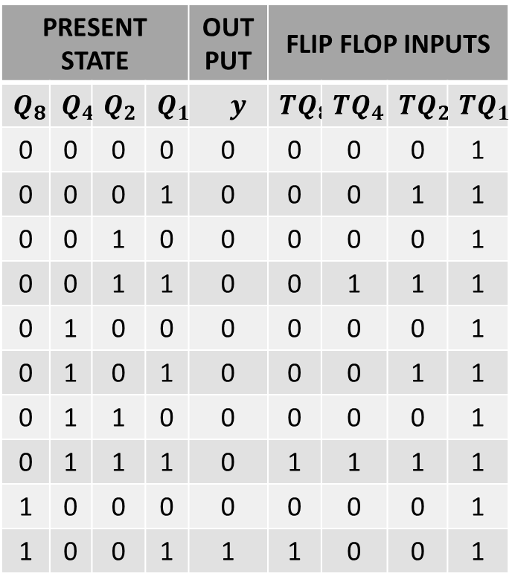
BCD COUNTER
PRESENT STATE |  |  |  | OUT PUT | FLIP FLOP INPUTS
$$Q_{8}$$ | $$Q_{4}$$ | $$Q_{2}$$ | $$Q_{1}$$ | $y$ | $${TQ}_{8}$$ | $${TQ}_{4}$$ | $${TQ}_{2}$$ | $${TQ}_{1}$$
0 | 0 | 0 | 0 | 0 | 0 | 0 | 0 | 1
0 | 0 | 0 | 1 | 0 | 0 | 0 | 1 | 1
0 | 0 | 1 | 0 | 0 | 0 | 0 | 0 | 1
0 | 0 | 1 | 1 | 0 | 0 | 1 | 1 | 1
0 | 1 | 0 | 0 | 0 | 0 | 0 | 0 | 1
0 | 1 | 0 | 1 | 0 | 0 | 0 | 1 | 1
0 | 1 | 1 | 0 | 0 | 0 | 0 | 0 | 1
0 | 1 | 1 | 1 | 0 | 1 | 1 | 1 | 1
1 | 0 | 0 | 0 | 0 | 0 | 0 | 0 | 1
1 | 0 | 0 | 1 | 1 | 1 | 0 | 0 | 1

Slide 37
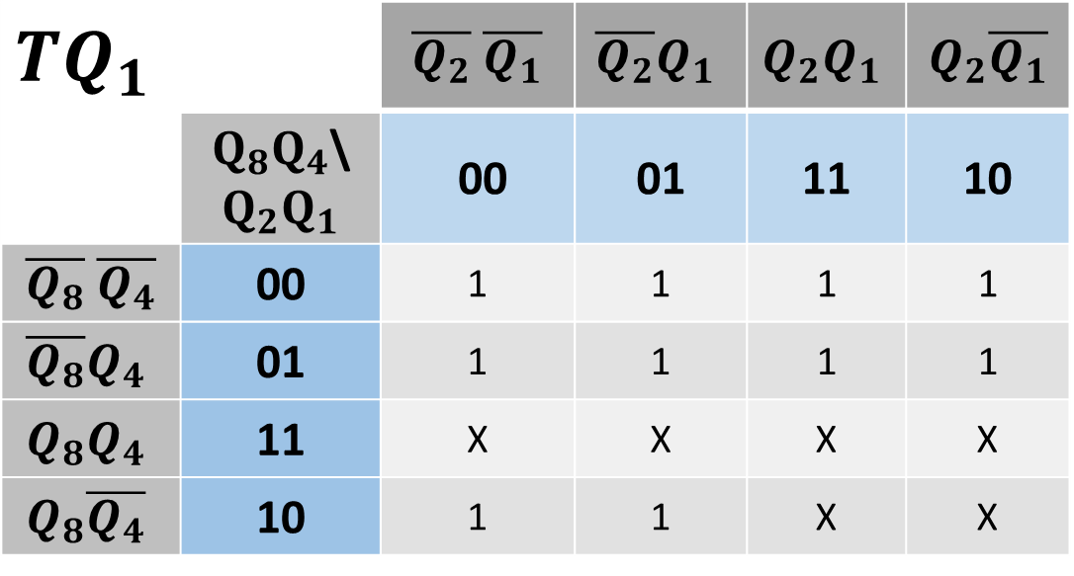
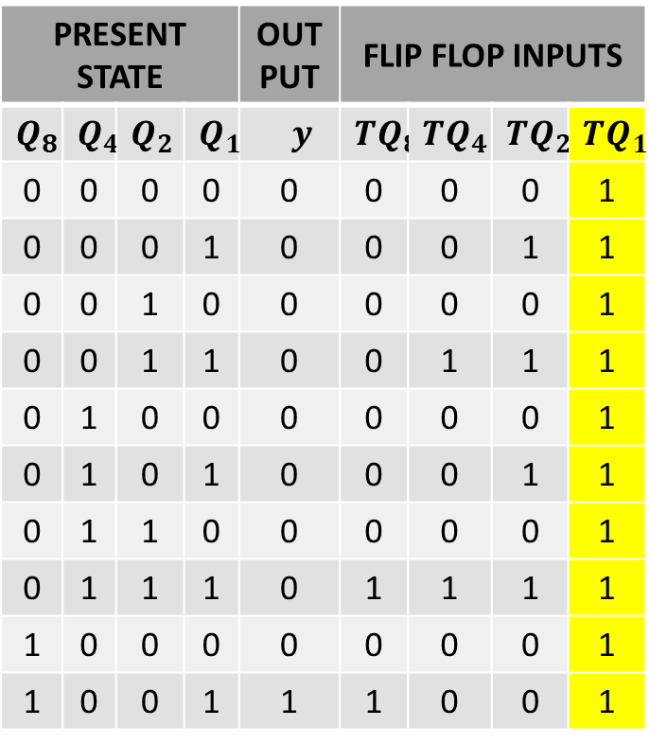
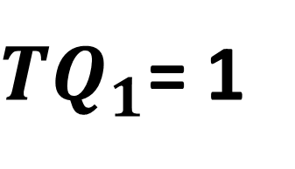
BCD COUNTER
PRESENT STATE |  |  |  | OUT PUT | FLIP FLOP INPUTS
$$Q_{8}$$ | $$Q_{4}$$ | $$Q_{2}$$ | $$Q_{1}$$ | $y$ | $${TQ}_{8}$$ | $${TQ}_{4}$$ | $${TQ}_{2}$$ | $${TQ}_{1}$$
0 | 0 | 0 | 0 | 0 | 0 | 0 | 0 | 1
0 | 0 | 0 | 1 | 0 | 0 | 0 | 1 | 1
0 | 0 | 1 | 0 | 0 | 0 | 0 | 0 | 1
0 | 0 | 1 | 1 | 0 | 0 | 1 | 1 | 1
0 | 1 | 0 | 0 | 0 | 0 | 0 | 0 | 1
0 | 1 | 0 | 1 | 0 | 0 | 0 | 1 | 1
0 | 1 | 1 | 0 | 0 | 0 | 0 | 0 | 1
0 | 1 | 1 | 1 | 0 | 1 | 1 | 1 | 1
1 | 0 | 0 | 0 | 0 | 0 | 0 | 0 | 1
1 | 0 | 0 | 1 | 1 | 1 | 0 | 0 | 1
$${TQ}_{1}$$ |  | $\overline{Q_{2}}$ $\overline{Q_{1}}$ | $$\overline{Q_{2}}Q_{1}$$ | $$Q_{2}Q_{1}$$ | $Q_{2}\overline{Q_{1}}$
 | $Q_{8}Q_{4}$\$Q_{2}Q_{1}$ | 00 | 01 | 11 | 10
$\overline{Q_{8}}$ $\overline{Q_{4}}$ | 00 | 1 | 1 | 1 | 1
$$\overline{Q_{8}}Q_{4}$$ | 01 | 1 | 1 | 1 | 1
$$Q_{8}Q_{4}$$ | 11 | X | X | X | X
$$Q_{8}\overline{Q_{4}}$$ | 10 | 1 | 1 | X | X
${TQ}_{1}$= 1

Slide 38

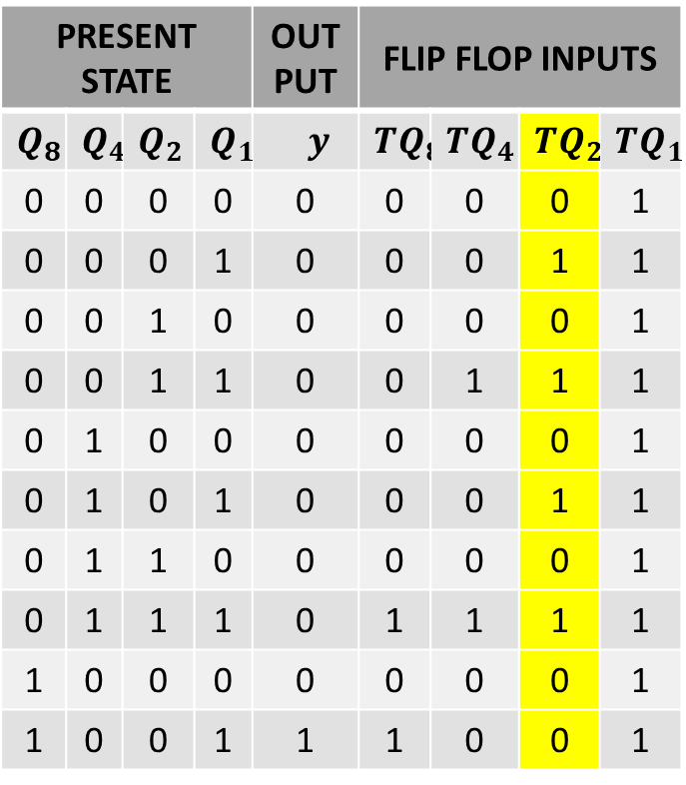
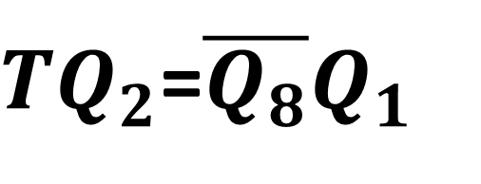
BCD COUNTER
PRESENT STATE |  |  |  | OUT PUT | FLIP FLOP INPUTS
$$Q_{8}$$ | $$Q_{4}$$ | $$Q_{2}$$ | $$Q_{1}$$ | $y$ | $${TQ}_{8}$$ | $${TQ}_{4}$$ | $${TQ}_{2}$$ | $${TQ}_{1}$$
0 | 0 | 0 | 0 | 0 | 0 | 0 | 0 | 1
0 | 0 | 0 | 1 | 0 | 0 | 0 | 1 | 1
0 | 0 | 1 | 0 | 0 | 0 | 0 | 0 | 1
0 | 0 | 1 | 1 | 0 | 0 | 1 | 1 | 1
0 | 1 | 0 | 0 | 0 | 0 | 0 | 0 | 1
0 | 1 | 0 | 1 | 0 | 0 | 0 | 1 | 1
0 | 1 | 1 | 0 | 0 | 0 | 0 | 0 | 1
0 | 1 | 1 | 1 | 0 | 1 | 1 | 1 | 1
1 | 0 | 0 | 0 | 0 | 0 | 0 | 0 | 1
1 | 0 | 0 | 1 | 1 | 1 | 0 | 0 | 1
$${TQ}_{2}$$ |  | $\overline{Q_{2}}$ $\overline{Q_{1}}$ | $$\overline{Q_{2}}Q_{1}$$ | $$Q_{2}Q_{1}$$ | $Q_{2}\overline{Q_{1}}$
 | $Q_{8}Q_{4}$\$Q_{2}Q_{1}$ | 00 | 01 | 11 | 10
$\overline{Q_{8}}$ $\overline{Q_{4}}$ | 00 | 0 | 1 | 1 | 0
$$\overline{Q_{8}}Q_{4}$$ | 01 | 0 | 1 | 1 | 0
$$Q_{8}Q_{4}$$ | 11 | X | X | X | X
$$Q_{8}\overline{Q_{4}}$$ | 10 | 0 | 0 | X | X
${TQ}_{2}$=$\overline{Q_{8}}Q_{1}$

Slide 39

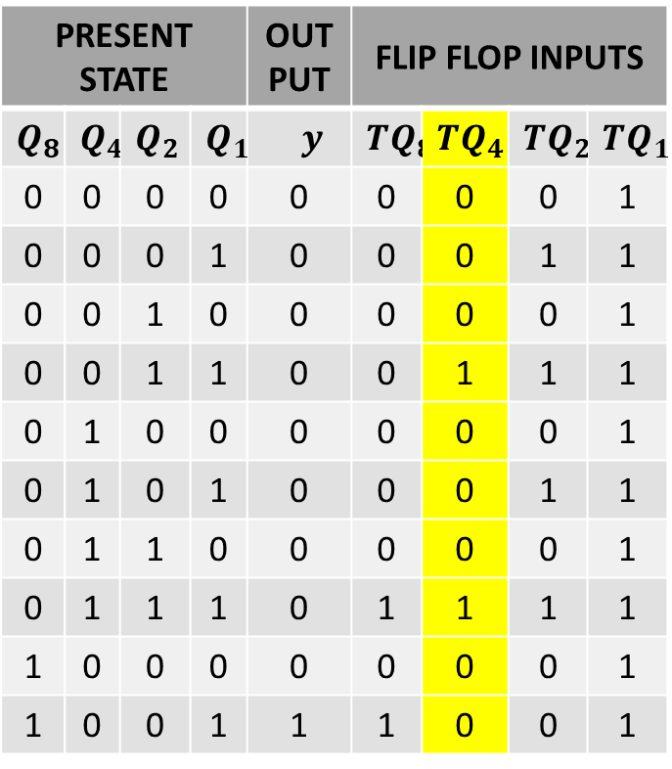
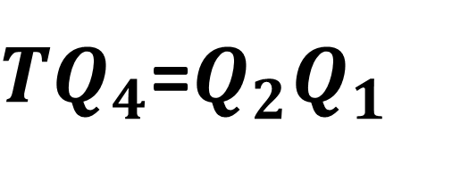
BCD COUNTER
PRESENT STATE |  |  |  | OUT PUT | FLIP FLOP INPUTS
$$Q_{8}$$ | $$Q_{4}$$ | $$Q_{2}$$ | $$Q_{1}$$ | $y$ | $${TQ}_{8}$$ | $${TQ}_{4}$$ | $${TQ}_{2}$$ | $${TQ}_{1}$$
0 | 0 | 0 | 0 | 0 | 0 | 0 | 0 | 1
0 | 0 | 0 | 1 | 0 | 0 | 0 | 1 | 1
0 | 0 | 1 | 0 | 0 | 0 | 0 | 0 | 1
0 | 0 | 1 | 1 | 0 | 0 | 1 | 1 | 1
0 | 1 | 0 | 0 | 0 | 0 | 0 | 0 | 1
0 | 1 | 0 | 1 | 0 | 0 | 0 | 1 | 1
0 | 1 | 1 | 0 | 0 | 0 | 0 | 0 | 1
0 | 1 | 1 | 1 | 0 | 1 | 1 | 1 | 1
1 | 0 | 0 | 0 | 0 | 0 | 0 | 0 | 1
1 | 0 | 0 | 1 | 1 | 1 | 0 | 0 | 1
$${TQ}_{4}$$ |  | $\overline{Q_{2}}$ $\overline{Q_{1}}$ | $$\overline{Q_{2}}Q_{1}$$ | $$Q_{2}Q_{1}$$ | $Q_{2}\overline{Q_{1}}$
 | $Q_{8}Q_{4}$\$Q_{2}Q_{1}$ | 00 | 01 | 11 | 10
$\overline{Q_{8}}$ $\overline{Q_{4}}$ | 00 | 0 | 0 | 1 | 0
$$\overline{Q_{8}}Q_{4}$$ | 01 | 0 | 0 | 1 | 0
$$Q_{8}Q_{4}$$ | 11 | X | X | X | X
$$Q_{8}\overline{Q_{4}}$$ | 10 | 0 | 0 | X | X
${TQ}_{4}$=$Q_{2}Q_{1}$

Slide 40
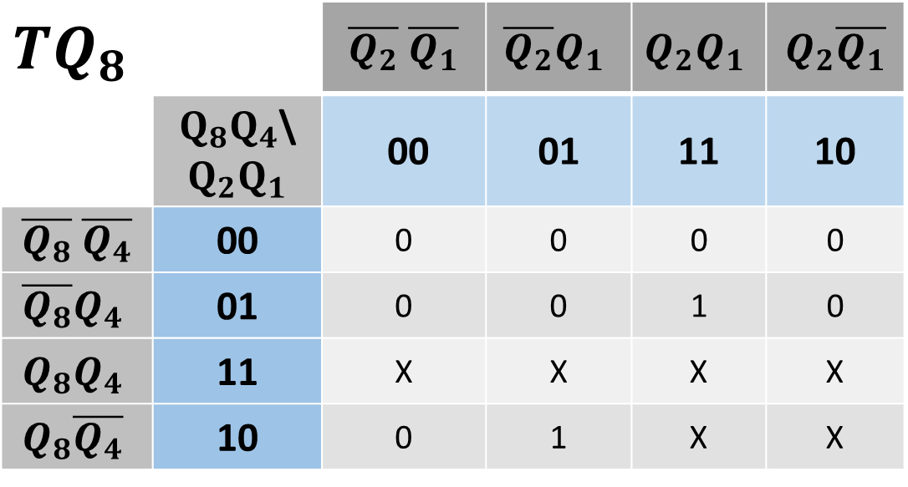
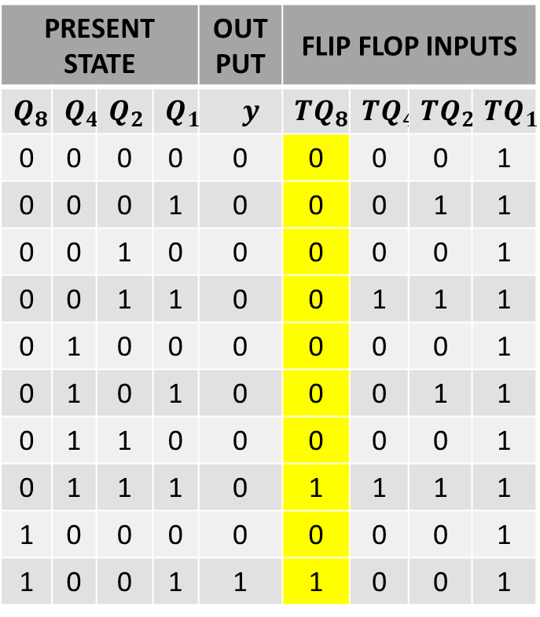
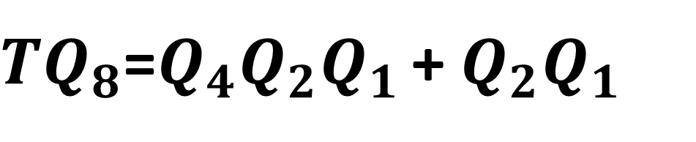
BCD COUNTER
PRESENT STATE |  |  |  | OUT PUT | FLIP FLOP INPUTS
$$Q_{8}$$ | $$Q_{4}$$ | $$Q_{2}$$ | $$Q_{1}$$ | $y$ | $${TQ}_{8}$$ | $${TQ}_{4}$$ | $${TQ}_{2}$$ | $${TQ}_{1}$$
0 | 0 | 0 | 0 | 0 | 0 | 0 | 0 | 1
0 | 0 | 0 | 1 | 0 | 0 | 0 | 1 | 1
0 | 0 | 1 | 0 | 0 | 0 | 0 | 0 | 1
0 | 0 | 1 | 1 | 0 | 0 | 1 | 1 | 1
0 | 1 | 0 | 0 | 0 | 0 | 0 | 0 | 1
0 | 1 | 0 | 1 | 0 | 0 | 0 | 1 | 1
0 | 1 | 1 | 0 | 0 | 0 | 0 | 0 | 1
0 | 1 | 1 | 1 | 0 | 1 | 1 | 1 | 1
1 | 0 | 0 | 0 | 0 | 0 | 0 | 0 | 1
1 | 0 | 0 | 1 | 1 | 1 | 0 | 0 | 1
$${TQ}_{8}$$ |  | $\overline{Q_{2}}$ $\overline{Q_{1}}$ | $$\overline{Q_{2}}Q_{1}$$ | $$Q_{2}Q_{1}$$ | $Q_{2}\overline{Q_{1}}$
 | $Q_{8}Q_{4}$\$Q_{2}Q_{1}$ | 00 | 01 | 11 | 10
$\overline{Q_{8}}$ $\overline{Q_{4}}$ | 00 | 0 | 0 | 0 | 0
$$\overline{Q_{8}}Q_{4}$$ | 01 | 0 | 0 | 1 | 0
$$Q_{8}Q_{4}$$ | 11 | X | X | X | X
$$Q_{8}\overline{Q_{4}}$$ | 10 | 0 | 1 | X | X
${TQ}_{8}$=$Q_{4}Q_{2}Q_{1 }$+ $Q_{2}Q_{1}$

Slide 41
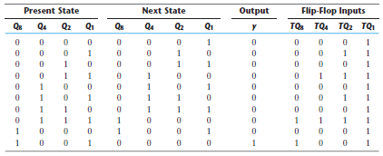
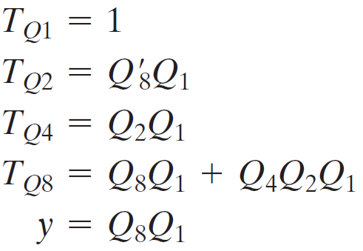
BCD COUNTER

Slide 42
Synchronous Counter with PARALLEL LOAD
LECTURE 10
Part 3

Slide 43
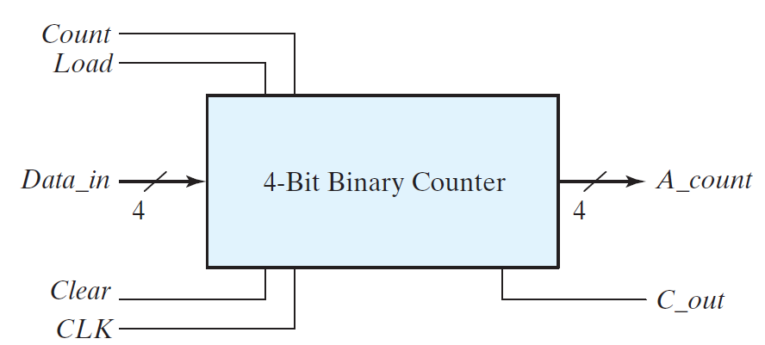
BINARY COUNTER with PARALLEL LOAD

Slide 44
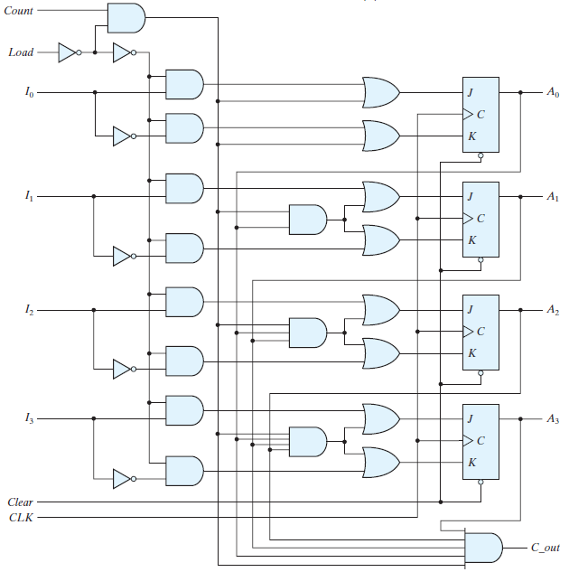
BINARY COUNTER with PARALLEL LOAD

Slide 45
BINARY COUNTER with PARALLEL LOAD
Clear | CLK | Load | Count | Function
0 | X | X | X
1 |  | 1 | X
1 |  | 0 | 1
1 |  | 0 | 0

Slide 46
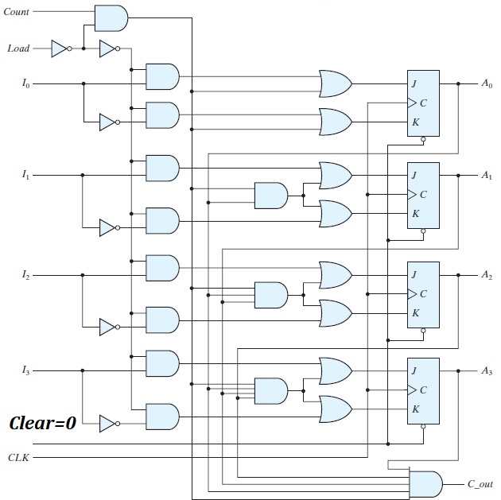
BINARY COUNTER with PARALLEL LOAD

Slide 47
BINARY COUNTER with PARALLEL LOAD
Clear | CLK | Load | Count | Function
0 | X | X | X | CLEAR to 0
1 |  | 1 | X
1 |  | 0 | 1
1 |  | 0 | 0

Slide 48
BINARY COUNTER with PARALLEL LOAD
Clear | CLK | Load | Count | Function
0 | X | X | X | CLEAR to 0
1 |  | 1 | X
1 |  | 0 | 1
1 |  | 0 | 0

Slide 49
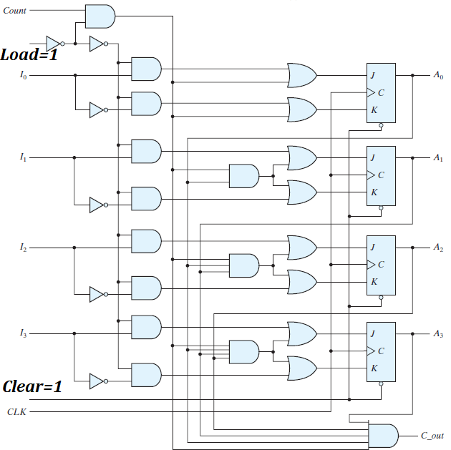
BINARY COUNTER with PARALLEL LOAD

Slide 50
BINARY COUNTER with PARALLEL LOAD
Clear | CLK | Load | Count | Function
0 | X | X | X | CLEAR to 0
1 |  | 1 | X | LOAD inputs
1 |  | 0 | 1
1 |  | 0 | 0

Slide 51
BINARY COUNTER with PARALLEL LOAD
Clear | CLK | Load | Count | Function
0 | X | X | X | CLEAR to 0
1 |  | 1 | X | LOAD inputs
1 |  | 0 | 1
1 |  | 0 | 0

Slide 52
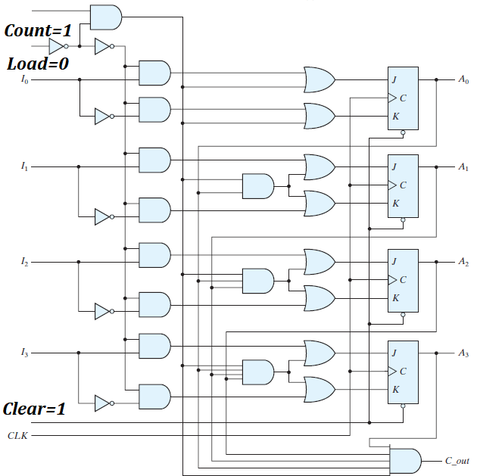
BINARY COUNTER with PARALLEL LOAD

Slide 53
BINARY COUNTER with PARALLEL LOAD
Clear | CLK | Load | Count | Function
0 | X | X | X | CLEAR to 0
1 |  | 1 | X | LOAD inputs
1 |  | 0 | 1 | COUNT to Next Binary state
1 |  | 0 | 0

Slide 54
BINARY COUNTER with PARALLEL LOAD
Clear | CLK | Load | Count | Function
0 | X | X | X | CLEAR to 0
1 |  | 1 | X | LOAD inputs
1 |  | 0 | 1 | COUNT to Next Binary state
1 |  | 0 | 0

Slide 55
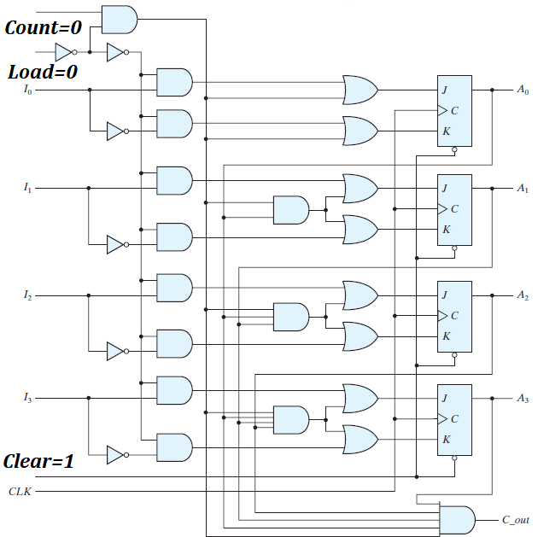
BINARY COUNTER with PARALLEL LOAD

Slide 56
BINARY COUNTER with PARALLEL LOAD
Clear | CLK | Load | Count | Function
0 | X | X | X | CLEAR to 0
1 |  | 1 | X | LOAD inputs
1 |  | 0 | 1 | COUNT to Next Binary state
1 |  | 0 | 0 | NO CHANGE

Slide 57
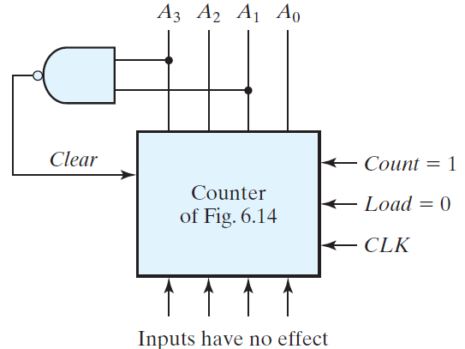
BINARY COUNTER with PARALLEL LOAD as DECADE COUNTER

Slide 58
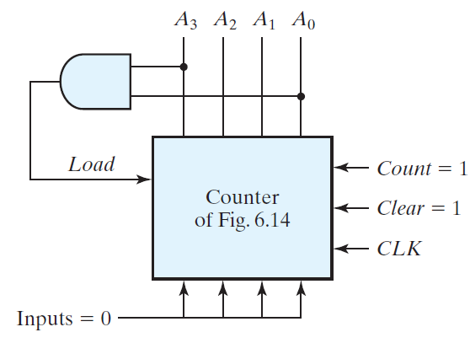
BINARY COUNTER with PARALLEL LOAD as DECADE COUNTER

Slide 59
Thanks

